Slide 1
Dictionary Lab

Slide 2
Dictionary Lab
Materials needed
Kali Linux Virtual Machine
Software Tool used
JTR (John the Ripper)
Password cracking tool (pre-installed on Kali OS)

Slide 3
Objectives Covered
Security+ Objectives (SY0-701)
Objective 2.4 - Explain the purpose of mitigation techniques used to secure the enterprise..
Hardening Techniques
Password Policies
Objective 2.5 - Given a scenario, analyze indicators of malicious activity
Password Attacks
Spraying (Dictionary)

Slide 4
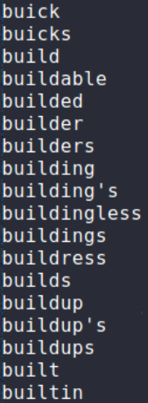
What is a Dictionary Attack?
A dictionary attack is a form of password attack where the attacker uses a pre-determined list of passwords, or dictionary, to attempt to crack a password.
This is part of the contents of a dictionary list pre-installed on most Kali systems. It can be found at the following directory:
/usr/share/ike-scan/

Slide 5
The Dictionary Lab
Setup Environment
Create dictionary
Create example users
Set example passwords
Locate password file
Launch the Attack
Observe results
Note: In this lab, you are going to create a dictionary of passwords that contains a list of names of people that you know.
From that list, you will create users with passwords that are contained within the dictionary.

Slide 6
Setup Environment
Log into your range
Open the Kali Linux Environment
You should be on your Kali Linux Desktop

Slide 7
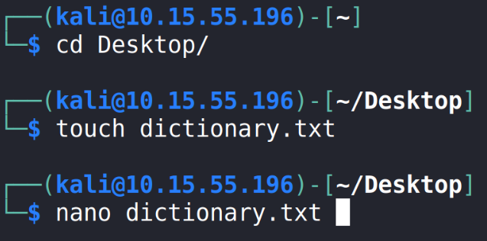
Create the Dictionary
Open Terminal in Kali
Navigate to the Desktop:
cd Desktop
Create a .txt file that will serve as the dictionary:
touch dictionary.txt
Open the dictionary file with a text editor
nano dictionary.txt

Slide 8
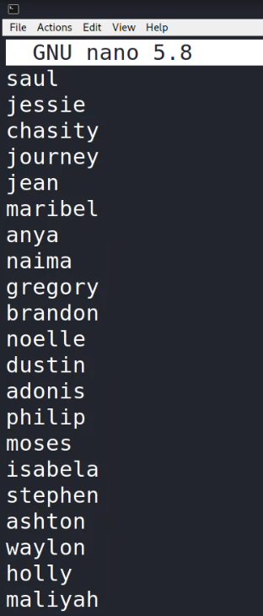
Creating the Dictionary
In the text editor, add a list of 20 names of people you know, just like the example on the right
Once finished, press CTRL+X to exit
Press Y to save
Press ENTER to save as the same name (dictionary.txt)
You can ensure the names are saved in the file by double clicking to open the file on the Desktop.

Slide 9
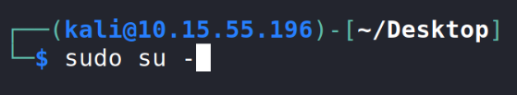

Create Users
Login as the root user with the following command:
sudo su -
Notice the command prompt is now root@kali
Create additional users by using the following command:
This command creates a user named “ginny”
useradd ginny
Create at least 3 users
Remember the users' names - you will need these to set passwords for them

Slide 10
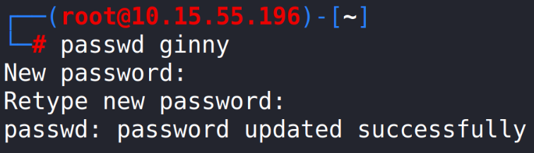
Set passwords
Use the following command to set a password for each account:
The following command starts the prompt to set a password for the user ginny
passwd ginny
Enter the password at the prompt “New password:”
Set the password to be one from the list of the names you added to the dictionary file earlier!
Repeat this step for all user accounts you created.

Slide 11

Locate Hashed Passwords
Navigate to the etc directory:
cd /etc
View the files
ls
The file passwd contains all the usernames on the system (See the accounts you created?)
In older systems, the password for each user was stored in the passwd file (That's why it's named that)
NOT a secure way of storing passwords!

Slide 12

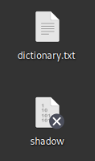
Locate Hashed Passwords
Linux switched over to hashing passwords and storing them in a file named shadow
Use the following command to see the hashed passwords in the shadow file:
cat shadow
Copy the shadow file to your Desktop using the following command: cp shadow /home/kali/Desktop
You should have both the dictionary.txt file and shadow file on your Desktop

Slide 13
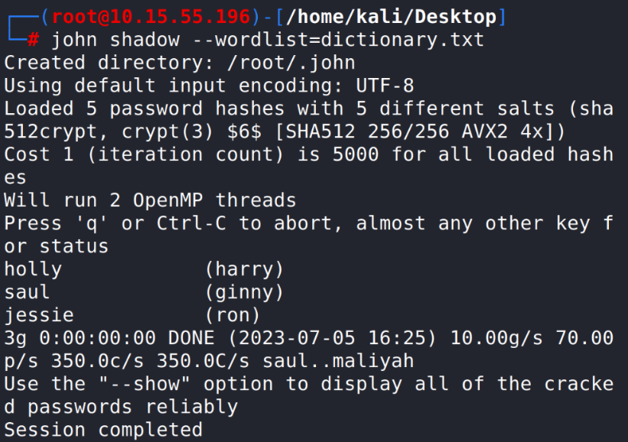
Launch the Attack
Navigate to the Desktop directory:
cd /home/kali/Desktop
To launch the attack with the dictionary you created, use the following command:
john shadow --wordlist=dictionary.txt
You should notice John The Ripper cracked the passwords very quickly using the dictionary that you created.
Please Note: If you see the following message, try the command (all one line). (The brute force offline lab would have had a similar issue)
john shadow --wordlist=dictionary.txt
–-format=crypt

Slide 14
How to Defend Against a Dictionary Attack
Do not use generic passwords or old passwords
Dictionary attacks use commonly-used passwords
Dictionary attacks often contain old passwords that make have been compromised in the past
Strong Passwords
Increasingly longer delay between failed attempts
Lockout after __ failed attempts
Two-Factor Authentication
Why would these help secure your password?
What are some other ways of defending against a dictionary attack?

Slide 15
Real Dictionaries
Real dictionary attacks use millions and billions of passwords.
The dictionary file sizes are enormous because of all the possible combinations they contain.
Where do these passwords come from?
When a cyberattack occurs, the culprits will sometimes leak usernames and passwords online. These are added into a continuously growing list of known passwords and circulated online.
A simple Google search will provide plenty of examples that can be used.

